Slide 1
PowerShell Security and Threat management
Jaap Brasser

Slide 2


Jaap Brasser
Blogger
JaapBrasser.com
PowerShell Magazine
Speaker
PowerShell Conference
Dutch PowerShell User Group
@Jaap_Brasser

Slide 3
Agenda
Windows Defender
Deep script logging and transcripts
Current security landscape
PowerShell as a threat

Slide 4
Windows Defender
Eleven cmdlets
Used for direct interaction with engine
Can be used to identify threats

Slide 5
Demo Remove threat using PowerShell

Slide 6
Remove threat demo
Windows Defender to identify the threat
Looked up information about the threat
Removed the threat
Checked in explorer what the results were

Slide 7
Transcription in PowerShell
Available in PowerShell since 1.0
Provide logging for console commands
Useful when experimenting with PowerShell

Slide 8
Security by transcription
Have a record of recent PowerShell activity
Troubleshooting
Investigating malicious actions
Auditing
Start-Transcript
Module-Logging

Slide 9
Over-the-shoulder Transcription
New in PowerShell 5.0
Allow for system wide transcription
Captures all streams into a log file
Can be stored on another system

Slide 10
Demo PowerShell Transcription

Slide 11
Deep script logging
New in PowerShell 5.0
Addition to transcription
Uses the event log to display what actions occur in script block
Can break script blocks into multiple parts

Slide 12
Demo Deep script logging

Slide 13

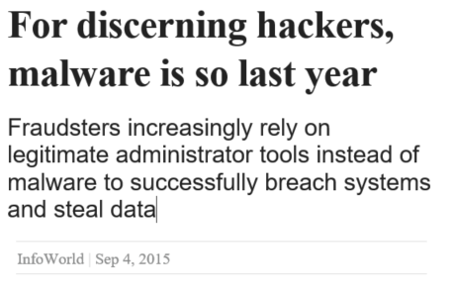
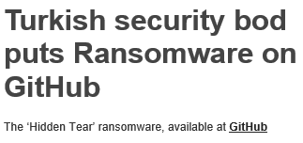
Current security landscape

Slide 14
PowerShell threats
File-less threats
Stored in registry, eventlog or task scheduler

Slide 15
Demo Detect threats using PowerShell

Slide 16
Detect File-less threats
Store PowerShell code in the registry
Setup a Runkey in the registry to execute code
Manipulate an existing Scheduled Task to execute code

Slide 17
More information
Demo code will be available on GitHub:
https://github.com/jaapbrasser/Events/tree/master/MSFestPraha2015
Additional information available:
http://www.jaapbrasser.com/tag/msfest/
http://www.twitter.com/Jaap_Brasser

Slide 18


